Slide 1
BARRIERS OF COMMUNICATION
1.USE OF JARGON.
2.DIFFERENCE IN PERCEPTION AND VIEWPOINT .
3.UNDERSTANDING WHAT IS SIAD.

Slide 2
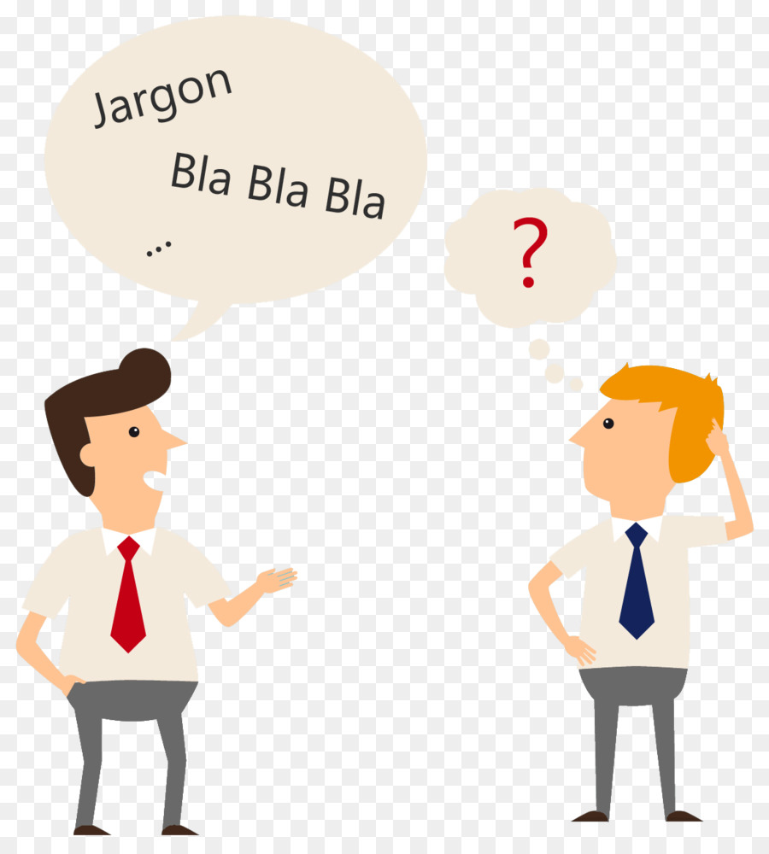
THE USE OF JARGON
Which means special words or expressions used by a profession or group that are difficult for others to understand.

Slide 3
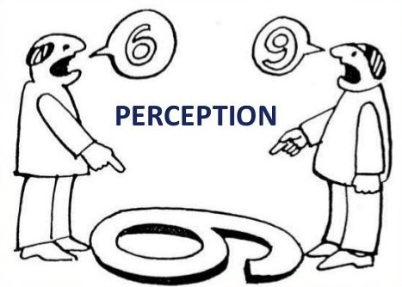
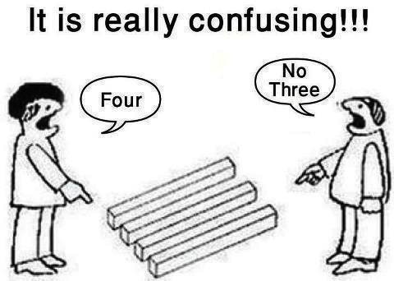
Difference in perception and viewpoint …
Perception is the ability to notice or understand something.

Slide 4
Viewpoint
Viewpoint is nothing but a way of looking at a situation or an opinion .
Your viewpoint is the particular way you see the world, or your distinct perspective on things. It's literally your point of view!
To stop arguing with someone, try to see things from their viewpoint .

Slide 5
Here is a short story to illustrate a person’s perception …..
In early 80’s a new airplane was invented. Its speciality was its bathroom. When the inventor brought it to the people , the world’s leaders of different countries travelled together in that plane. During the boarding time as usual all the precautions and rules to be followed during an emergency situation was explained by the airhostess, and the speciality of that plane was also revealed ……..

Slide 6
Continuation…………..
During the plane travel the passengers don’t need to take bath themselves , but the computer program takes care of it . To take bath you need to just press 6 buttons which work as follows
1.Removes you clothes
2.Wets you with water
3.Applies soap and cleans you from top to bottom
4.Pours water to wash off the soap
5.It dries you and gets you dressed
6.Pushes you off from the bathroom
All the passengers were asked to press 1 to 6 buttons for taking bath.

Slide 7
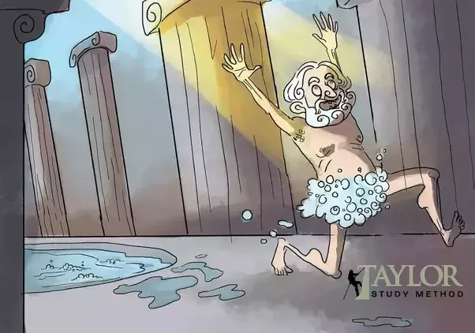
Continuation….
The Chinese president who knows only a bit of English went into the bathroom and as said he pressed the buttons 1 2 and 6…..
The plane removed his clothes , poured water on him and pushed outside of the bathroom …..

Slide 8
Importance of understanding properly what is said
So with the help of the story the importance of understanding what is to be understood is explained…
There’s a famous tongue twister as follows
“if u understand say understand , if you don’t understand say don’t understand . But if understand and say don’t understand , how do I understand that you understand . Understand ?”.
According to me this is not only a tongue twister but also
a saying that helps us to UNDERSTAND the importance of UNDERSTANDING and conveying the same .

Slide 9
THANK YOU …..
BY P.AKASH PRABHU

